Slide 1

OpenCV Tutorial
VIDEO ANALYTICS
CS/SE 6327 - Special Topics
Spring 2016
Instructor: B. Prabhakaran
TA: Kanchan Bahirat (kab131130@utdallas.edu)
Slides Credit: Myunghoon Suk
create your future
www.utdallas.edu

Slide 2
Contents
Introduction to OpenCV
How to setup OpenCV
Examples
Useful links

Slide 3
Introduction to OpenCV
OpenCV (Open Source Computer Vision):
  A library of programming functions for real time computer vision.
  Released under a BSD license and hence it’s free for both academic and commercial use.
Interfaces:
  C++ / C / Python / JAVA
OS:
  Windows / Linux / Mac OS / iOS / Android

Slide 4
Introduction to OpenCV
Most Recent Version:
  3.1 (21/12/2015)
For more information, http://opencv.org
For downloads, http://opencv.org/downloads.html
For complete documentation, http://docs.opencv.org
For quick start, http://opencv.org/quickstart.html

Slide 5

Quick Start http://opencv.org/quickstart.html
Quick Start
LATEST TUTORIALS

Slide 6
Installation in Windows
Download from:
  http://sourceforge.net/projects/opencvlibrary/files/opencv-win/
Two options of Installation:
  Installation by Using the Pre-built Libraries
  Installation by Making Your Own Libraries from the Source Files
  While the first one is easier to complete, it only works if you are coding with the latest Microsoft Visual Studio IDE and doesn’t take advantage of the most advanced technologies we integrate into our library.

Slide 7
Using the Pre-built Libraries
Choose a version and Download OpenCV from the website.
Start the setup and follow the wizard.
Install to the location where you want.
  e.g. C:\OpenCV2.4.6
MS Windows 8
Visual Studio 2010 Professional
OpenCV 2.4.6

Slide 8
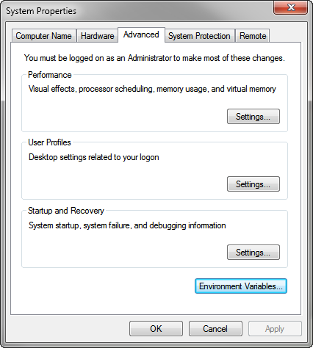
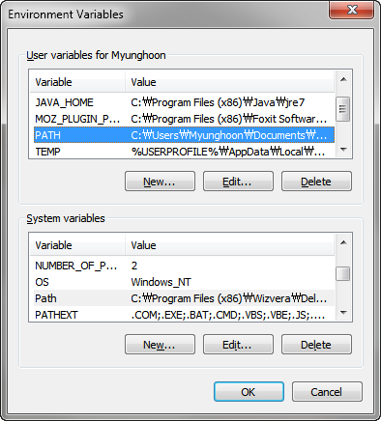
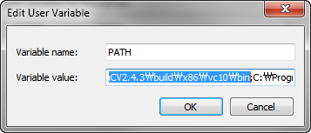
Set Environment Variables
Add the OpenCV library to the system path.
  e.g. C:\OpenCV2.4.6\build\x86\vc10\bin
MS Windows 8

Slide 9
vc8 = Visual Studio 2005
vc9 = Visual Studio 2008
vc10 = Visual Studio 2010
vc11 = Visual Studio 2012
vc12 = Visual Studio 2013

Slide 10
Build applications with OpenCV
In Visual Studio
Unlike Dynamic Linked Libraries (DLL), static libraries with lib extensions can be used. When you use this the library will be built-in inside your exe file.
To build an application with OpenCV,
  Tell to the compiler how the OpenCV library looks. You do this by showing it the header files.
  Tell to the linker from where to get the functions or data structures of OpenCV, when they are needed.

Slide 11
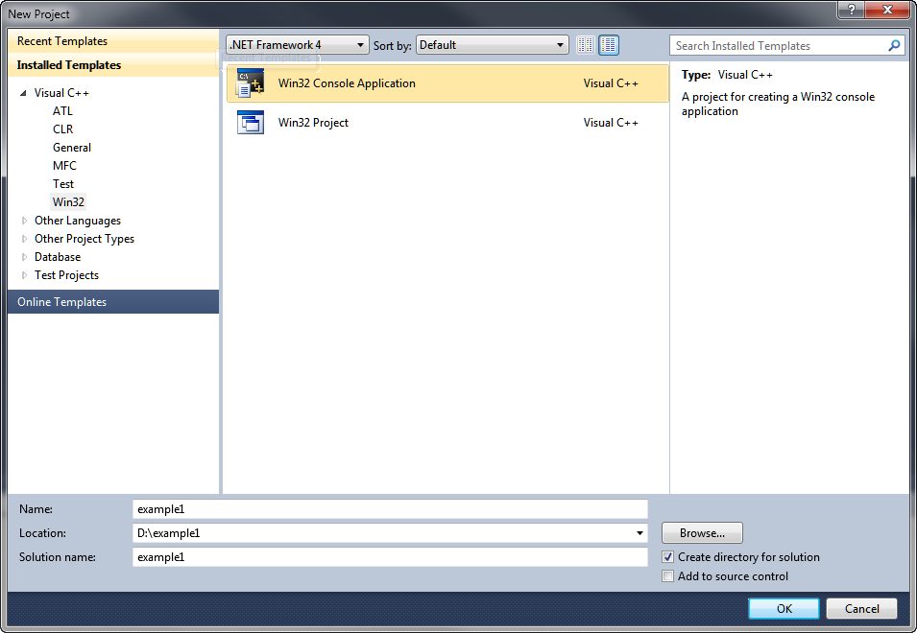
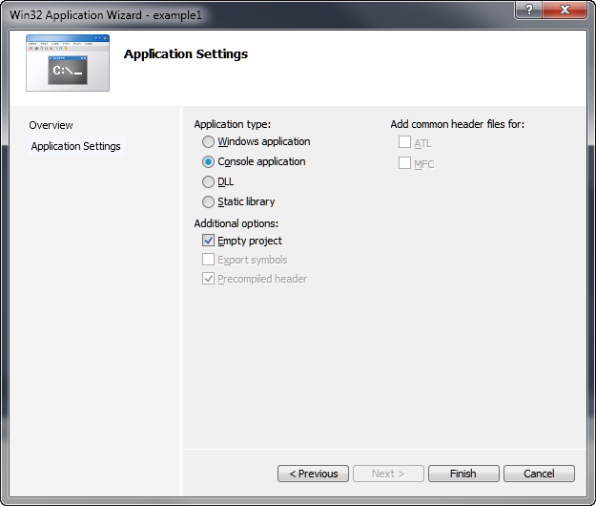
Set up OpenCV in Visual Studio
Create a Win32 Console empty project called “example1”.

Slide 12
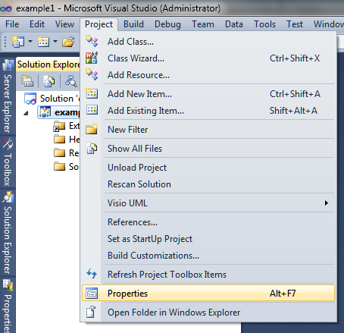
Set up OpenCV in Visual Studio
Select “Project” in Menu and click on “properties”.
MS Windows 7
Visual Studio 2010 Professional
OpenCV 2.4.6

Slide 13
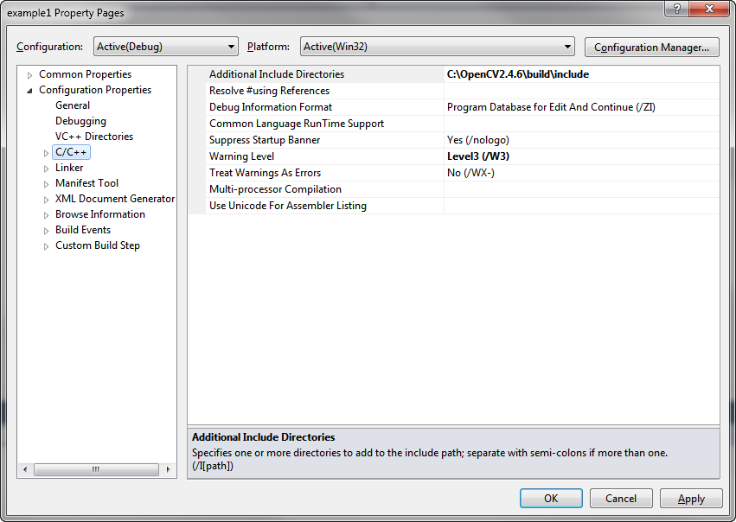
Set up OpenCV in Visual Studio
“Configuration Properties” -> “C/C++” -> “Additional Include Directories”
<OpenCV Installation Folder>\build\include
e.g. C:\OpenCV2.4.6\build\include

Slide 14
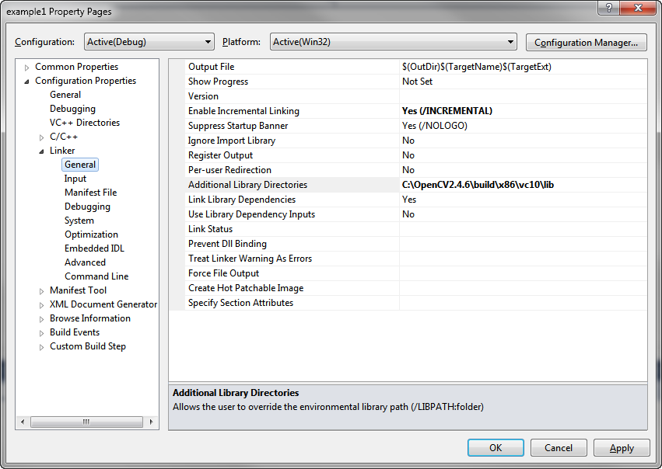
Set up OpenCV in Visual Studio
“Linker” -> “General” -> “Additional Library Directories”
<OpenCV Installation Folder>\build\x86\vc10\lib
e.g. C:\OpenCV2.4.6\build\x86\vc10\lib

Slide 15
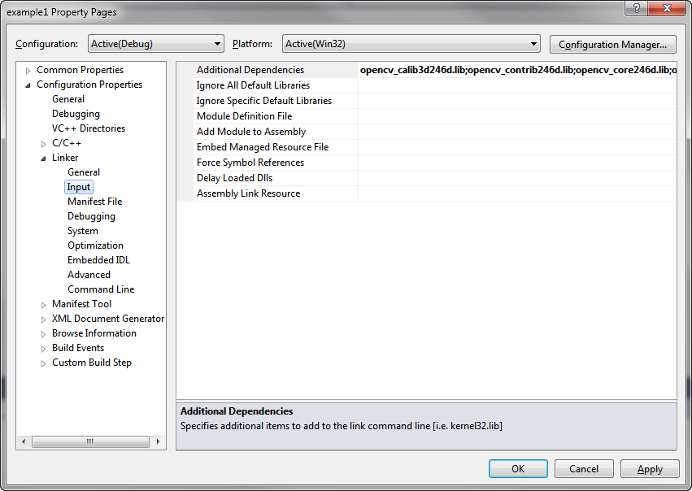
Set up OpenCV in Visual Studio
“Linker” -> “Input” -> “Additional Dependencies”

Slide 16
Set up OpenCV in Visual Studio
Configuration (Debug)
opencv_calib3d246d.lib
opencv_contrib246d.lib
opencv_core246d.lib
opencv_features2d246d.lib
opencv_flann246d.lib
opencv_gpu246d.lib
opencv_haartraining_engined.lib
opencv_highgui246d.lib
opencv_imgproc246d.lib
opencv_legacy246d.lib
opencv_ml246d.lib
opencv_nonfree246d.lib
opencv_objdetect246d.lib
opencv_ocl246d.lib
opencv_photo246d.lib
opencv_stitching246d.lib
opencv_superres246d.lib
opencv_ts246d.lib
opencv_video246d.lib
opencv_videostab246d.lib
Make sure these lib files are under your installation directory in “lib” folder.
  “C:\OpenCV2.4.6\build\x86\vc10\lib”
Different OpenCV versions will have different lib file names.
  “opencv_core246d.lib”
The letter d at the end just indicates that these are the libraries required for the Debug.
Make sure to omit the d letters from the library names for the Release.

Slide 17
Test it!
#include <opencv2/core/core.hpp>
#include <opencv2/highgui/highgui.hpp>
#include <iostream>
using namespace cv;
using namespace std;
int main( int argc, char** argv )
{
Mat image;
image = imread(argv[1], IMREAD_COLOR); // Read the file
if (! image.data ) // Check for invalid input
{
cout << "Could not open or find the image" << std::endl ;
return -1;
}
namedWindow( "Display window", WINDOW_AUTOSIZE ); // Create a window for display.
imshow( "Display window", image ); // Show our image inside it.
waitKey(0); // Wait for a keystroke in the window
return 0;
}

Slide 18
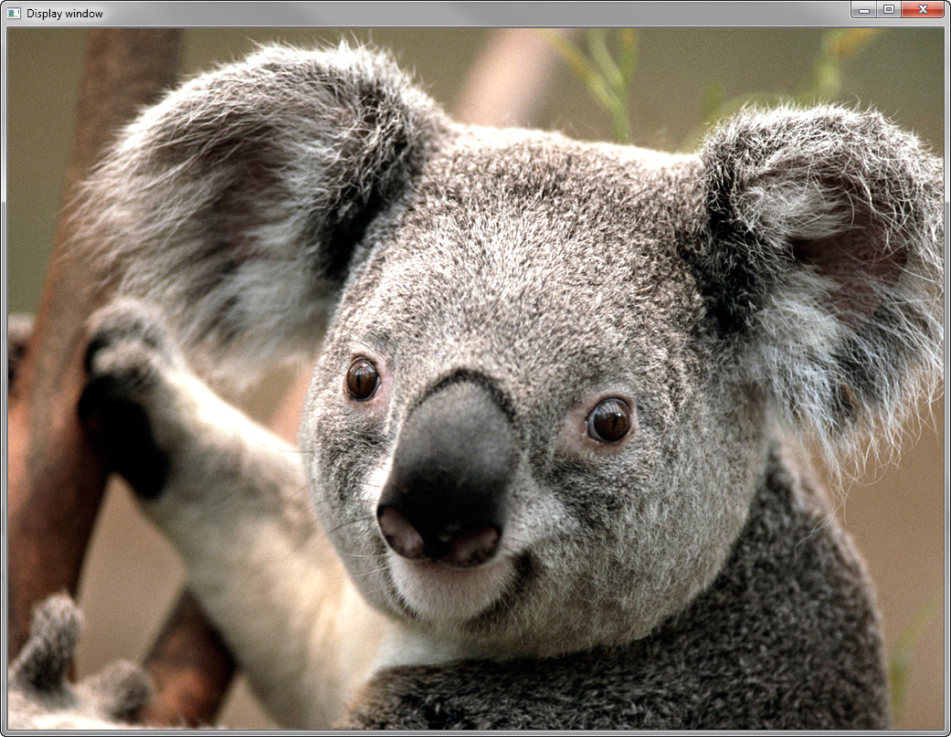
Test it!
Build -> Build Solution (F7)
<Project directory>\example1\Debug> example1.exe "C:\Users\Public\Pictures\Sample Pictures\Koala.jpg"

Slide 19
More tutorials & Samples
Sample source codes
  C:\OpenCV2.4.6\samples
  C:\OpenCV2.4.6\samples\cpp
Documents
  C:\OpenCV2.4.6\build\docs
  opencv_cheatsheet.pdf
  opencv_tutorials.pdf
  opencv_user.pdf
  opencv2manager.pdf
  opencv2refman.pdf

Slide 20
More tutorials & Samples
OpenCV Tutorials
  http://docs.opencv.org/doc/tutorials/tutorials.html
  core module - The Core Functionality
  imgproc module - Image Processing
  highgui module - High Level GUI and Media
  calib3d module - Camera calibration and 3D reconstruction
  feature2d module - 2D Features framework
  video module - Video analysis
  objdetect module - Object Detection
  ml module - Machine Learning
  gpu module - GPU-Accelerated Computer Vision
  contrib module - The additional contributions made available !
  OpenCV iOS

Slide 21
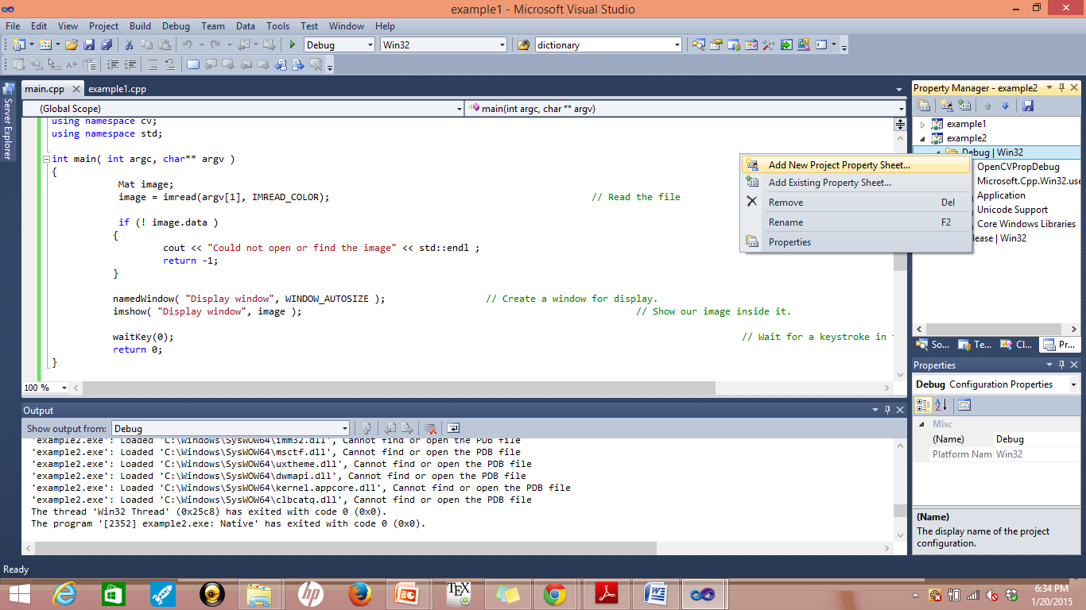
Preparing Property sheets
Go to Property Manager → Select Project → Select Debug

